Slide 1
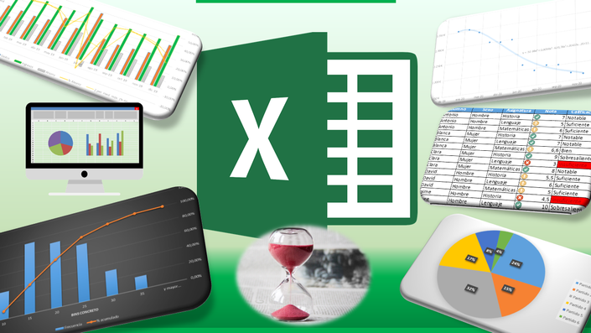
Grade Tracker
Students Performance Report

Slide 2
